Slide 1

Tour Management
System
SQL Project

Slide 2


Abstract
TravelVerse is a Tour Management System that manages customers, destinations, tour packages, hotels, bookings, payments, and reviews. It helps travel agencies organize travel operations efficiently, track business performance, and improve customer service through effective database management.

Slide 3
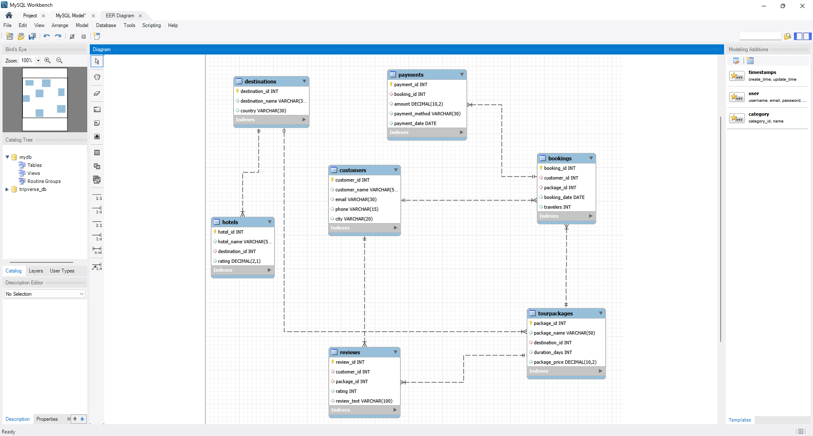
ER-Diagram

Slide 4

Structure of Tables
Tables
Customers table
Destinations table
Hotels table
TourPackages table
Bookings table
Payments table
Reviews table

Slide 5
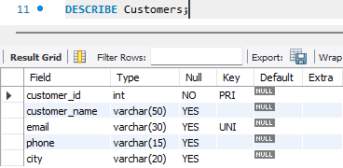
Structure of Customers Table
The Customers table stores customer information and is used to manage customer records in the TravelVerse system.
Syntax: DESCRIBE Customers;

Slide 6
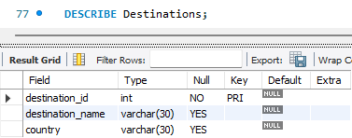
Structure of Destinations Table
The Destinations table stores information about travel destinations available for tours. It helps organize and manage destination details.
Syntax: DESCRIBE Destinations;

Slide 7
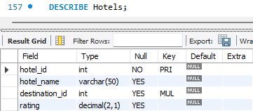
Structure of Hotels Table
The Hotels table stores information about hotels available at different destinations. It helps manage accommodation options for travelers.
Syntax: DESCRIBE Hotels;

Slide 8
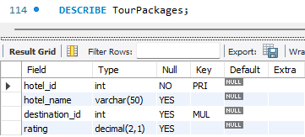
Structure of TourPackages Table
The TourPackages table stores details of tour packages offered to customers. It includes package information such as price and destination.
Syntax: DESCRIBE TourPackages;

Slide 9
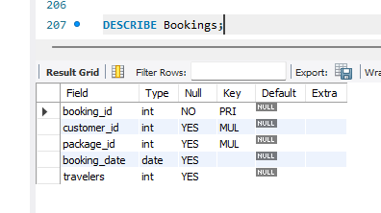
Structure of Bookings Table
The Bookings table stores records of tour package bookings made by customers. It links customers with their selected tour packages and travel details.
Syntax: DESCRIBE Bookings;

Slide 10
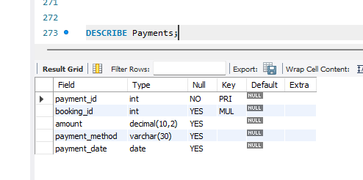
Structure of Payments Table
The Payments table stores payment details related to customer bookings. It helps track transaction amounts, payment methods, and payment dates.
Syntax: DESCRIBE Payments;

Slide 11
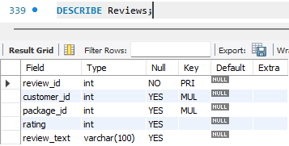
Structure of Reviews Table
The Reviews table stores customer feedback and ratings for tour packages. It helps measure customer satisfaction and service quality.
Syntax: DESCRIBE Reviews;

Slide 12
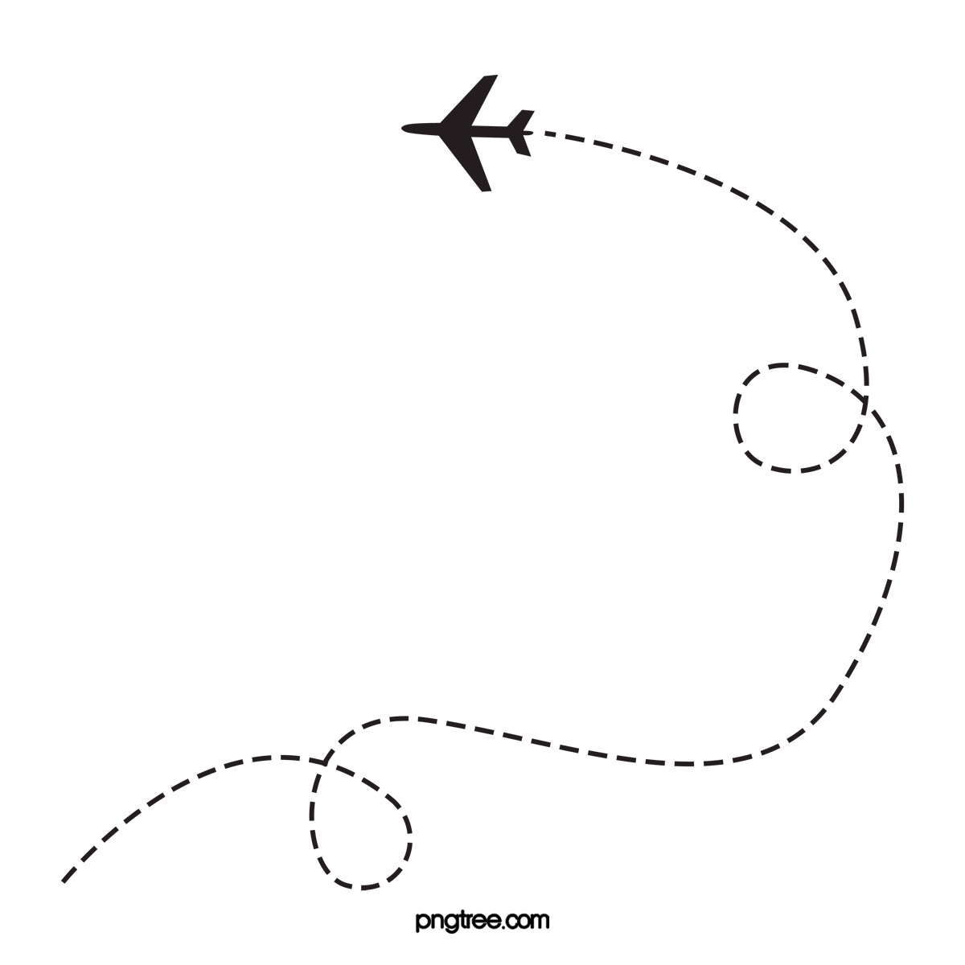
Contents of Tables

Slide 13
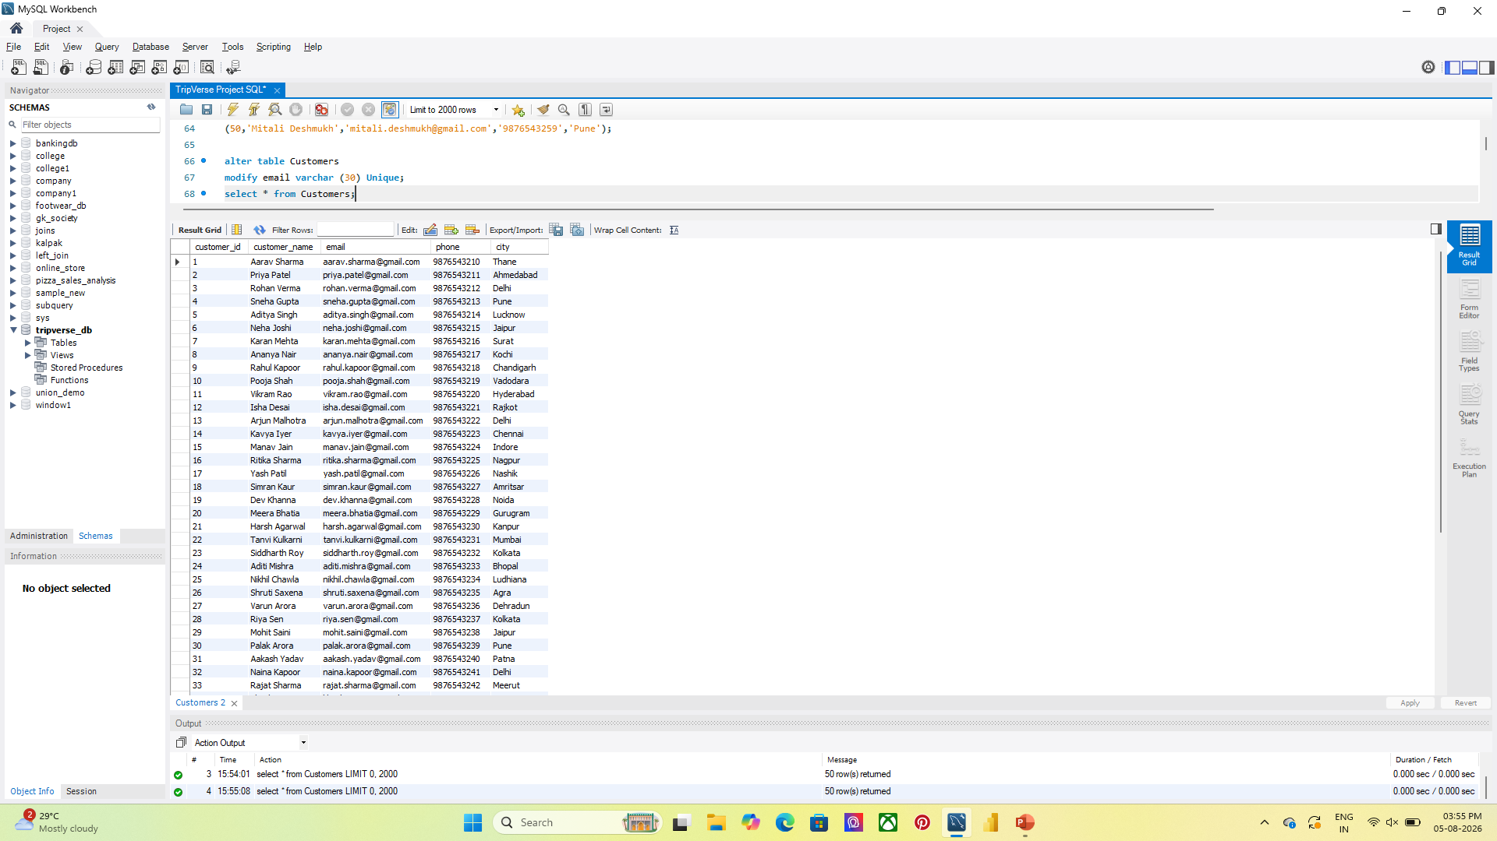
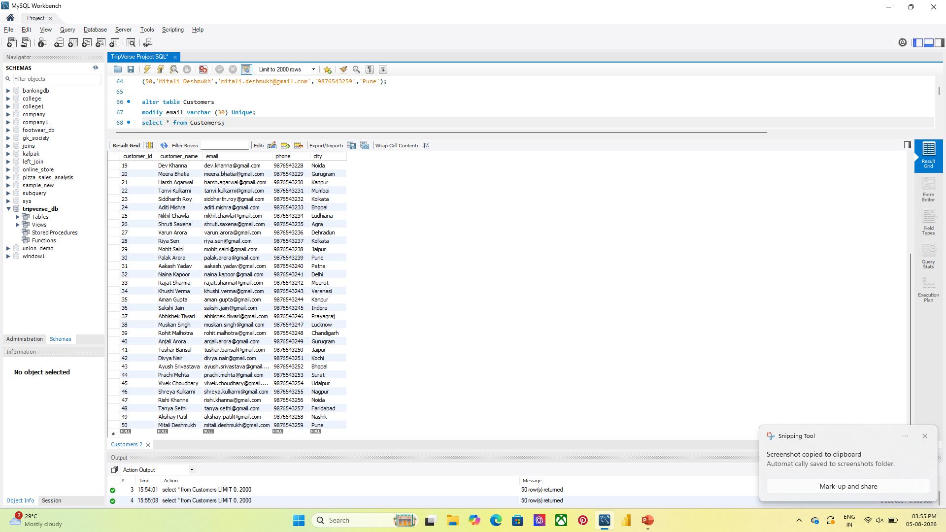
Contents of Customers Table
This table contains Customer ID, Customer Name, Email, Phone Number, City, as customer-related attributes.
Syntax: select * from Customers;

Slide 14
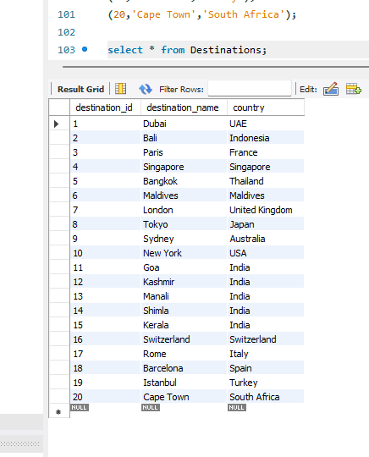
Contents of Destinations Table
The table contains Destination ID, Destination Name, Country, and other destination-related details.
Syntax: select * from Destinations;

Slide 15
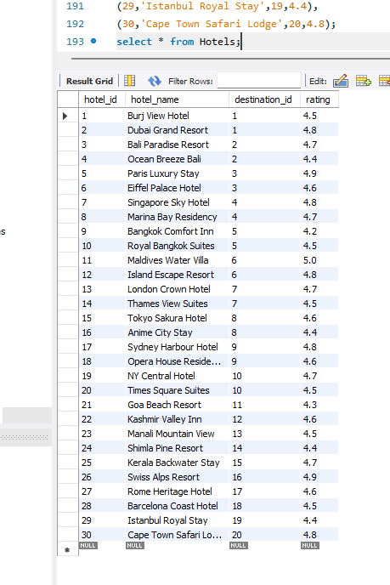
Contents of Hotels table
This table contains Hotel ID, Hotel Name, Destination ID, and Rating, allowing customers to compare accommodation options while planning their tours.
Syntax: select * from Hotels;

Slide 16
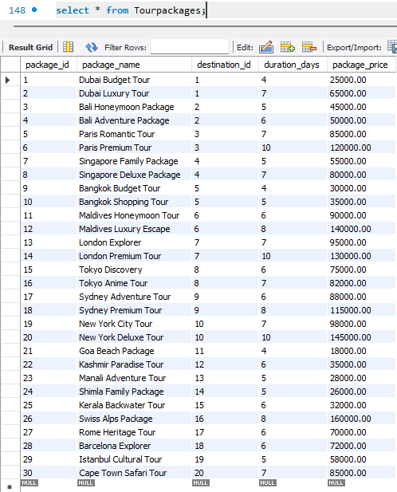
Contents of TourPackages Table
This table contains Package ID, Package Name, Destination ID, Duration, and Package Price, allowing customers to choose suitable travel packages based on their preferences and budget.
Syntax: select * from TourPackages;

Slide 17
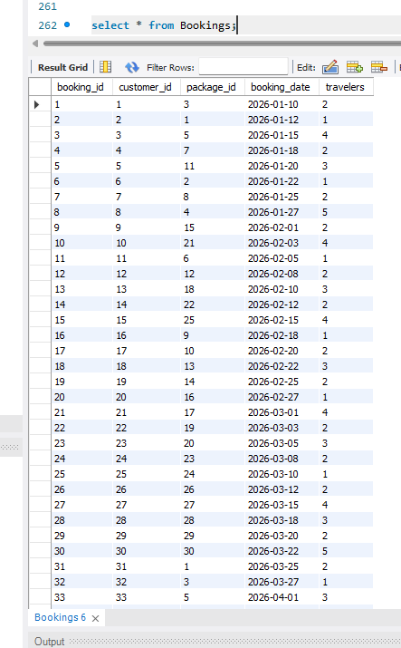
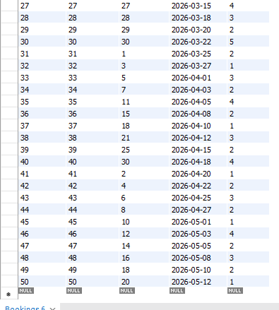
Contents of Bookings Table
This table contains Booking ID, Customer ID, Package ID, Booking Date, and Number of Travelers, allowing the system to track customer reservations and travel details.
Syntax: select * from Bookings;

Slide 18
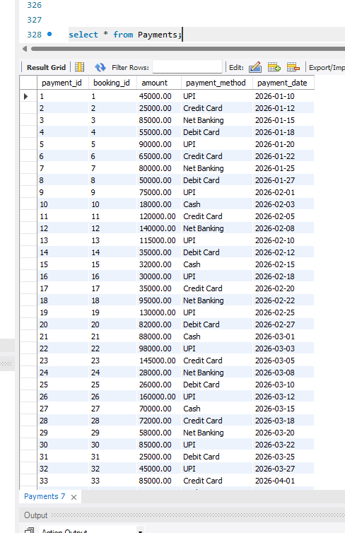
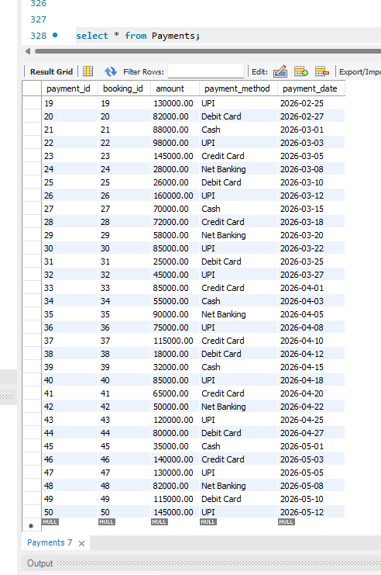
Contents of Payments table
This table contains Payment ID, Booking ID, Amount, Payment Method, and Payment Date, allowing the system to track booking transactions and payment history.
Syntax: select * from payments;

Slide 19
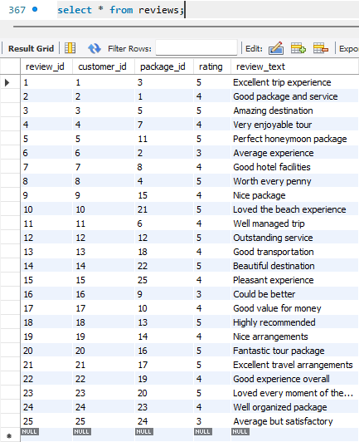
Contents of Reviews Table
This table contains Review ID, Customer ID, Package ID, Rating, and Review Comment, allowing the system to evaluate customer satisfaction and package performance.
Syntax: select * from Reviews;

Slide 20
JOINS

Slide 21
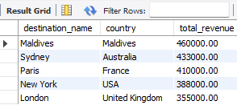
Joins
which destination generated the highest total revenue (INNER JOIN)
Syntax:
select
d.destination_name,
d.country,
sum(p.amount) as total_revenue
From destinations d
INNER JOIN TourPackages tp
ON d.destination_id = tp.destination_id
INNER JOIN Bookings b
ON tp.package_id = b.package_id
INNER JOIN Payments p
ON b.booking_id = p.booking_id
Group By d.destination_name, d.country
Order By total_revenue DESC
Limit 5;

Slide 22
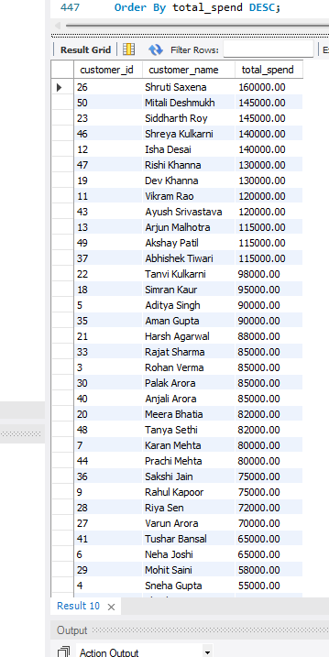
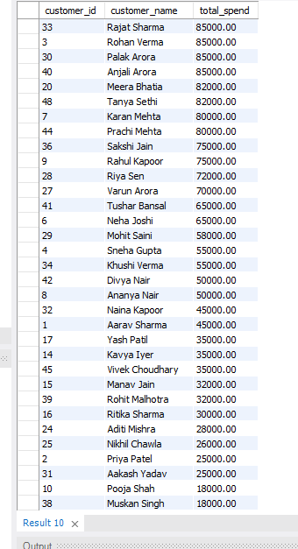
Joins
who are the top most customers based on total spending (INNER JOIN)
Syntax:
select
c.customer_id,
c.customer_name,
SUM(p.amount) as total_spend
From customers c
INNER JOIN Bookings b
ON c.customer_id = b.customer_id
INNER JOIN Payments p
ON p.booking_id = b.booking_id
Group By c.customer_id, c.customer_name
Order By total_spend DESC;

Slide 23
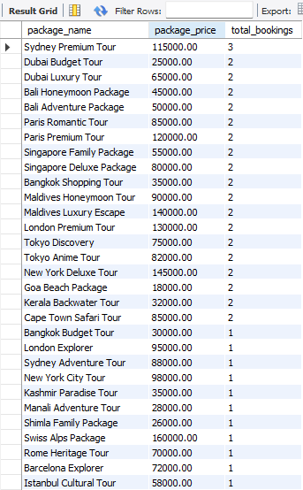
Joins
which tourpackages have never been booked (LEFT JOIN)
Syntax:
select
tp.package_name,
tp.package_price,
COUNT(b.booking_id) as total_bookings
FROM TourPackages tp
LEFT JOIN Bookings b
ON tp.package_id = b.package_id
Group By tp.package_name, tp.package_price
Order By total_bookings DESC;

Slide 24
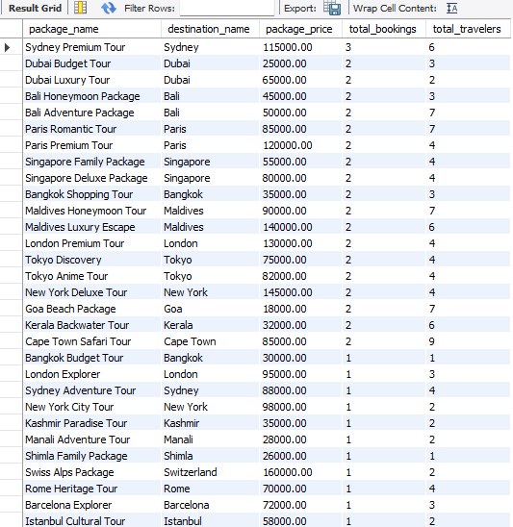
Joins
Which TourPackages are underperforming compared to others (LEFT JOIN)
Syntax:
select
tp.package_name,
d.destination_name,
tp.package_price,
COUNT(b.booking_id) as total_bookings,
IFNULL(sum(b.travelers),0) as total_travelers
FROM TourPackages tp
LEFT JOIN Destinations d
ON tp.destination_id = d.destination_id
LEFT JOIN Bookings b
ON tp.package_id = b.package_id
Group By tp.package_name, d.destination_name, tp.package_price
Order By total_bookings DESC;

Slide 25
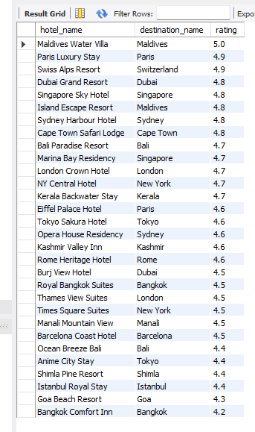
Joins
List all hotel along with their destination and rating (RIGHT JOIN)
Syntax:
Select
h.hotel_name,
d.destination_name,
h.ratingFROM Destinations d
RIGHT JOIN Hotels h
ON d.destination_id= h.destination_id
where h.rating >=4.0
Order By h.rating DESC;

Slide 26
SUBQUERIES

Slide 27
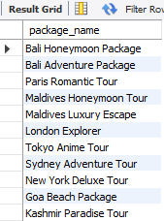
Subqueries
Which packages are rated better than the overall averages rating?
Syntax:
select package_name from TourPackages
Where package_id IN
(select package_id from Reviews
Group By package_id
Having avg(rating) >
(select avg(rating) from reviews));

Slide 28
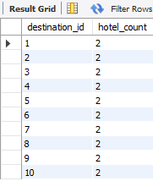
Subqueries
Which destination have more hotel options than the average destination
Syntax:
select destination_id , COUNT(*) as hotel_count
From Hotels
Group By destination_id
Having COUNT(*) >
(select AVG(hotel_count)
From
(select COUNT(*) AS hotel_count
From Hotels
Group By destination_id) t);

Slide 29
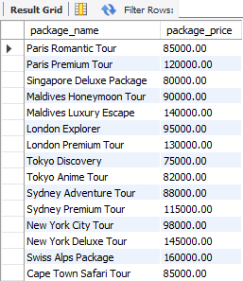
Subqueries
Which packages have a price higher than the average package price
Syntax:
select package_name, package_price
From TourPackages
Where package_price >
(select ROUND(AVG(package_price),2)
From TourPackages);

Slide 30
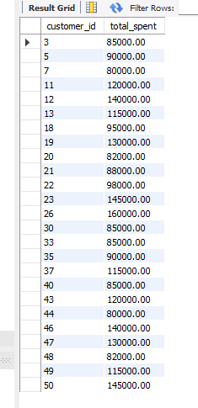
Subqueries
Which customers have spent more than the average customer spending
Syntax:
select b.customer_id, SUM(p.amount) AS total_spent
From Bookings b, Payments p
Where b.booking_id = p.booking_id
Group By b.customer_id
Having SUM(p.amount) >
(select AVG(customer_total)
From
(select SUM(p2.amount) AS customer_total
From Bookings b2, Payments p2
Where b2.booking_id = p2.booking_id
Group By b2.customer_id)t);

Slide 31
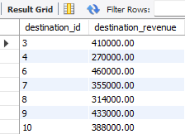
Subqueries
which destination generates more revenue than the average destination
Syntax:
Select tp.destination_id, SUM(p.amount) as destination_revenue From TourPackages tp, Bookings b, Payments p
Where tp.package_id = b.package_id
AND b.booking_id = p.booking_id
Group By tp.destination_id
Having SUM(p.amount) >
(select AVG(destination_revenue)
From
(select SUM(p2.amount) AS destination_revenue
From TourPackages tp2, Bookings b2, Payments p2
Where tp2.package_id = b2.package_id
AND b2.booking_id = p2.booking_id
Group By tp2.destination_id) t);

Slide 32
VIEWS

Slide 33
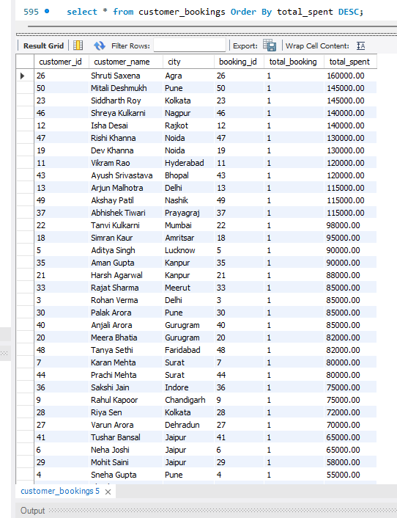
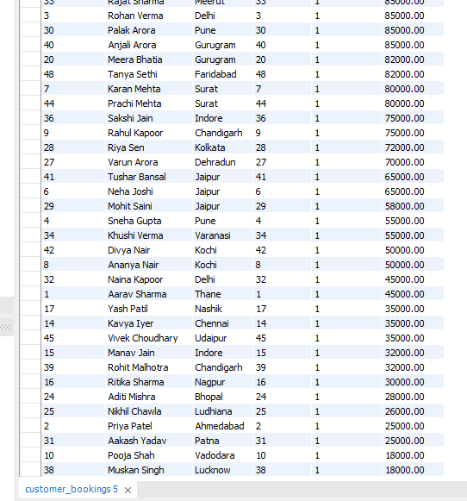
Views
CUSTOMER BOOKING
Syntax:
Create View customer_bookings AS
select
c.customer_id, c.customer_name,
c.city, b.booking_id,
COUNT(b.customer_id) AS total_booking,
SUM(p.amount) AS total_spent
FROM Customers c
JOIN Bookings b
ON c.customer_id = b.customer_id
JOIN Payments p
ON b.booking_id = p.booking_id
Group By c.customer_id, c.customer_name, c.city, b.booking_id;

Slide 34
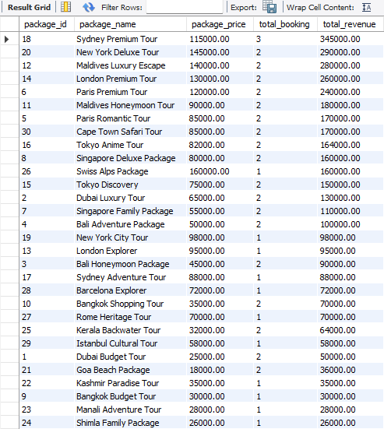
Views
Package Performance
Syntax:
Create View package_performance AS
Select
tp.package_id,
tp.package_name,
tp.package_price,
COUNT(b.booking_id) AS total_booking,
SUM(p.amount) AS total_revenue
From TourPackages tp
JOIN Bookings b
ON tp.package_id = b.package_id
JOIN Payments p
ON b.booking_id = p.booking_id
Group By tp.package_id, tp.package_name, tp.package_price;

Slide 35
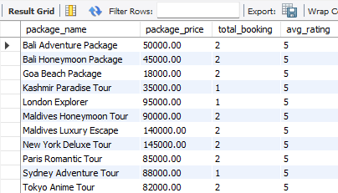
Views
High rated packages
Syntax:
Create View high_rated_packages AS
Select
tp.package_name, tp.package_price,
COUNT(DISTINCT b.booking_id) AS total_booking,
ROUND(AVG(r.rating),0) AS avg_rating
From TourPackages tp
JOIN Reviews r
ON tp.package_id = r.package_id
JOIN Bookings b
ON tp.package_id = b.package_id
Group By tp.package_name, tp.package_price
Having AVG(r.rating) > 4.0;

Slide 36
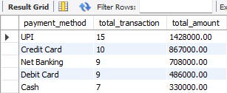
Views
payment method
Syntax:
Create View payment_method AS
Select
payment_method,
COUNT(*) AS total_transaction,
SUM(amount) AS total_amount
From Payments
Group By payment_method
Order By total_amount DESC;

Slide 37
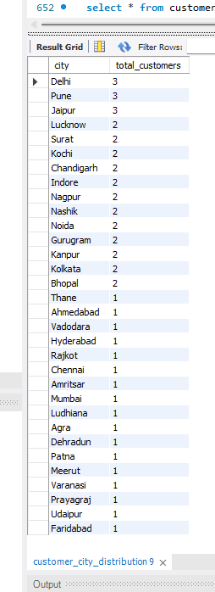
Views
City-wise customer distribution
Syntax:
Create View customer_city_distribution AS select
city,
COUNT(*) AS total_customers
From Customers
Group By city
Order By total_customers DESC;

Slide 38
WINDOW FUNCTIONS

Slide 39
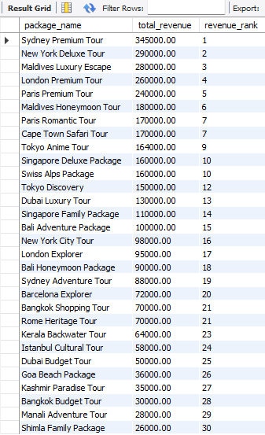
Window Function
Rank all packages by Total Revenue
Syntax:
Select
tp.package_name,
SUM(p.amount) AS total_revenue,
RANK()
Over (Order By SUM(p.amount) DESC) AS revenue_rank
From TourPackages tp
Join Bookings b
ON tp.package_id = b.package_id
Join Payments p
ON b.booking_id = p.booking_id
Group By tp.package_name;

Slide 40
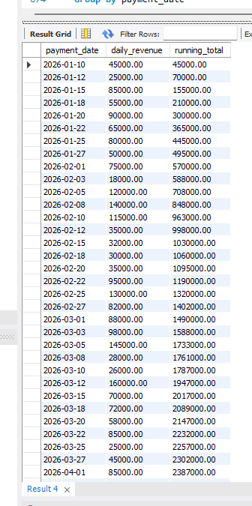
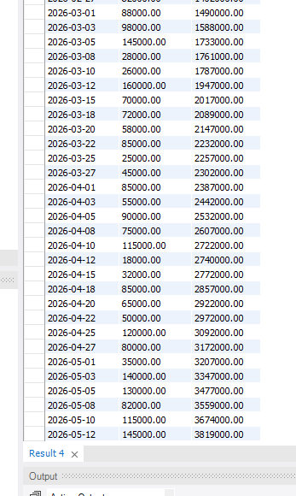
Window Function
Cumulative Revenue growth over time (Running Total)
Syntax:
Select
payment_date,
SUM(amount) AS daily_revenue,
SUM(SUM(amount))
Over (Order By payment_date) AS running_total
From Payments
Group By payment_date
Order By payment_date;

Slide 41
Prepared By
Kalpak K Khandbhor
ITVedant – Data Science & Data Analytics with Artificial Intelligence – T380
TravelVerse – Tour Management System Database Project

Slide 42
Thank you keep exploring the world

